Slide 1
Make it cheap: learning with O(nd) complexity
Włodzisław Duch^{1,2}, Norbert Jankowski¹ and Tomasz Maszczyk¹
¹ Department of Informatics, Nicolaus Copernicus University, Toruń, Poland
² School of Computer Engineering, Nanyang Technological University, Singapore
Google: W. Duch
WCCI, 6/2012

Slide 3
Are we doing the right thing? Perhaps simplest approach is sufficient?

Slide 4
Perhaps the data is trivial?

Slide 5
Data mining packages
GhostMiner, data mining tools from our lab + Fujitsu: http://www.fqspl.com.pl/ghostminer/
Separate the process of model building (hackers) and knowledge discovery, from model use (lamers) => GM Developer & Analyzer
No free lunch => provide different type of tools for knowledge discovery: decision tree, neural, neurofuzzy, similarity-based, SVM, committees, tools for visualization of data.
Support the process of knowledge discovery/model building and evaluating, organizing it into projects.
Many other interesting DM packages of this sort exists: Weka, Yale, Orange, Knime ... >170 packages on the-data-mine.com list!
We are building Intemi, radically new DM tools.

Slide 6
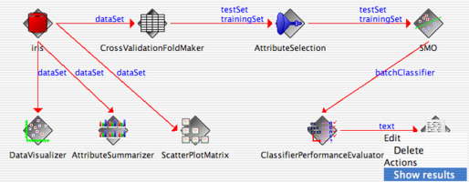
What DM packages do?
Hundreds of components ... transforming, visualizing ...
Visual “knowledge flow” to link components, or script languages (XML) to define complex experiments.
Rapid Miner 5.2, type and # components: total 712 (March 2012)
Process control 38
Data transformations 114
Data modeling 263
Performance evaluation 31
Other packages 266
Text, series, web ... specific transformations, visualization, presentation, plugin extensions ... ~ billions of models!

Slide 8
Test the simplest methods with O(nd) complexity & use them first in meta-learning.
Provide reference results.
Compare with state-of-the-art results.
Identify trivial cases.

Slide 9
Six O(nd) classifiers (n = # samples, d= dimensionality).
MC, Majority Classifier.

Slide 10
2. 1NP, Nearest Prototype classifier
Prototypes taken from class means, Euclidean distance only.

Slide 11
3. LVQ, Learning Vector Quantization
Start from random vector (start from 1NP does not change it much), iterate to optimize codebook positions.

Slide 12
4. MLC, Maximum Likelihood Classifier
1NP but with Gaussian function, dispersions calculated for each feature.

Slide 13
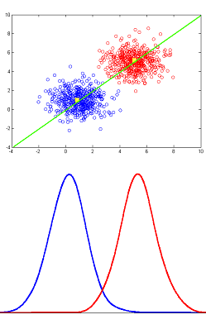
MLC is optimal for Gaussian distributions with the same p(C_{k}).

Slide 14
5. NB, Naive Bayes Classifier
Like MLC but using posterior probability

Slide 15
6. K2MLP, or MLP with fixed resources
For K classes:
# of hidden nodes = K(K-1)/2
# of iterations = 30
# learning rate = 0.1
Simple backpropagation training.

Slide 16
Reference State-of-the-Art results:
Linear SVM, with optimized C
Gaussian kernel SVM, with optimized C, σ

Slide 17
45 benchmark problems.
UCI repository data:
Vectors with missing values removed.
nominal features converted to binary using temperature coding.
10-fold CV, averaged over 10 runs.
Wilcoxon test to check significance.

Slide 18
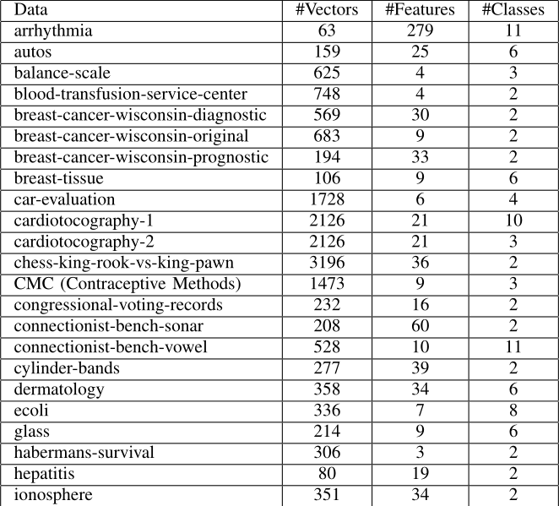
Data I

Slide 19
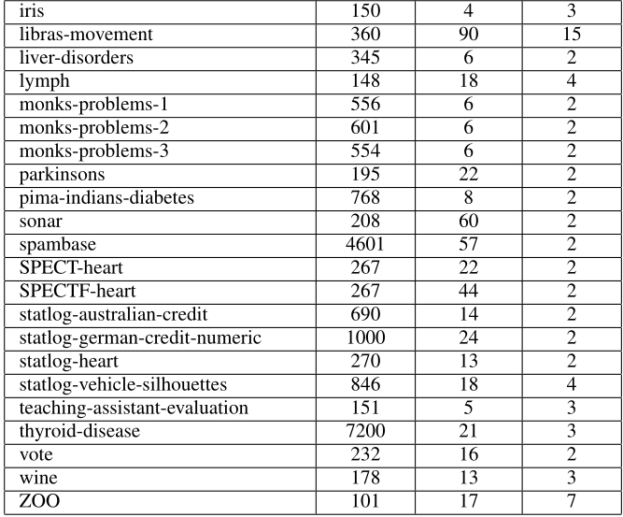
Data II

Slide 20
Only 13 out of 45 problems are non-trivial, less than 30%!
For these problems G-SVM is significantly better than O(nd) methods.

Slide 21
Trivial data examples
Data: dermatology
MC 31.0±1.0
1NP 96.9±3.2
LVQ 91.3±3.8
MLC 88.4±4.6
NB 90.1±4.5
K2M 94.9±3.8
LSVM 94.0±3.5
GSVM 94.5±3.9
lymph
54.7±4.5
86.4±8.6
82.5±9.4
78.8±9.4
81.2±8.9
82.7±9.2
81.3±9.8
83.6±9.8
TA-evaluation
34.5± 2.7
50.9±12.7
33.1±3.6
48.6±12.8
50.7±12.5
52.1±12.0
13.3±9.9
42.4±9.4

Slide 22
Non-trivial data examples
Data: car-evaluation
MC 70.0±0.2
1NP 73.2±2.9
LVQ 73.6±3.6
MLC 84.1±2.5
NB 87.1±1.9
K2M 91.1±2.5
LSVM 69.6±2.0
GSVM 98.8±0.8
silhouettes
25.1±0.5
45.3±4.6
25.8±0.9
53.0±4.2
45.7±4.0
72.9±4.7
69.9±2.7
79.8±2.7
chess
52.2±0.1
86.3±1.3
61.4±15.2
83.9±1.7
88.1±1.3
90.9±3.3
96.2±1.4
99.3±0.4

Slide 23
Non-trivial data examples: signals
Data: sonar
MC 53.4±2.2
1NP 69.7±7.5
LVQ 71.7±7.4
MLC 70.6±6.0
NB 69.0±8.7
K2M 76.7±8.1
LSVM 75.5±8.3
GSVM 85.5±5.3
vowel
7.6±0.1
52.0±6.6
9.1±1.4
52.0±6.0
67.5±6.3
81.0±5.0
25.8±5.0
96.8±2.2
ionosphere
64.1±1.4
81.1±6.4
83.7±5.3
59.2±6.2
84.2±6.2
86.5±5.5
87.7±4.6
94.6±3.7

Slide 24
Non-trivial data examples: medical
Data: thyroid cardio
MC 92.6±0.1
1NP 71.1±1.8
LVQ 92.6±0.1
MLC 86.6±1.4
NB 95.5±0.4
K2M 94.7±2.2
LSVM 93.8±0.5
GSVM 97.5±0.7
tocograph2
77.9±0.3
76.6±1.8
77.9±0.3
73.7±2.2
82.5±1.9
87.3±2.7
87.5±1.5
92.1±2.0
parkinson
75.4±3.2
73.6±8.7
77.8±6.9
78.2±8.5
69.8±9.1
85.6±7.6
86.3±10.2
93.3±5.6

Slide 25
Wins/ties/losses
MC 1NP LVQ
26 | 72 | 122 76 | 61 | 83 66 | 61 | 93
MLC NB K2MLP
68 | 62 | 90 100 | 59 | 61 130 | 61 | 29

Slide 26
1NP frequently wins, for some datasets (dermatology, lymph, statlog-AU-credit, ZOO) is better than any other method.
K2MLP and Naive Bayes show the lowest number of losses and highest number of wins.
NB is usually better than MLC, but not always.

Slide 27
NB is usually better than MLC, but not always.
In a few cases MC was the best! Ex:
blood-transfusion-service-center
breast-cancer-wisconsin-prognostic
SPECTF-heart
No info in this data? Just noise?

Slide 28
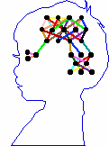
Summary
Most of the UCI benchmark problems are trivial.
Identification of trivial datasets is important, results provide good baseline to assess improvements of new methods.
They should not be the only basis for evaluation.
O(nd) methods should be tried first on real problems, perhaps they are trivial.
Cheap methods are worth studying and there is plenty of room to improve upon this study.

Slide 29
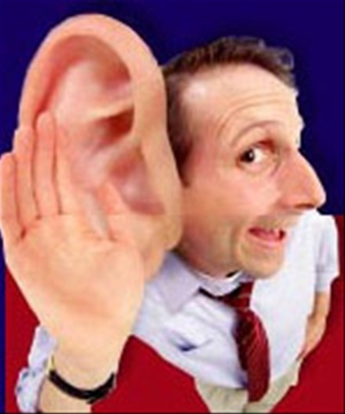
Thank you for lending your ears!
Google: W. Duch => Papers & presentations & more

